Slide 1
Patient specific numerical simulation of flow in the upper airways
Master thesis spring 2016
Maria Rolstad Jordal

Slide 2
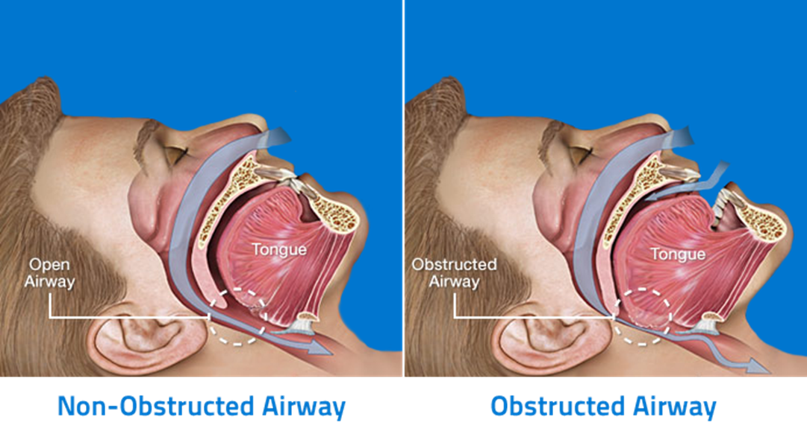
Motivation
Demonstrate the potential of a new patient-specific clinical tool based on mathematical models to predict the response to Obstuctive Sleep Apnea Syndrome (OSAS) treatment

Slide 3
Tasks to be considered
Generate 3D specific models of the upper airways (UA) before and after surgical intervention based on CT data
Grid generation, refinement/convergence studies
Numerical simulation of inhaling flow in the patient’s UA before and after surgery.
Qualitative comparison of flow in the UA before and after surgery based on CFD results
Compare the CFD results with measured data
Can the change in flow pattern be correlated to the change in AHI?

Slide 4
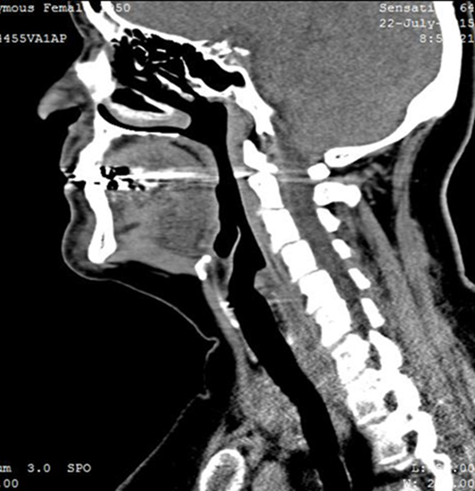
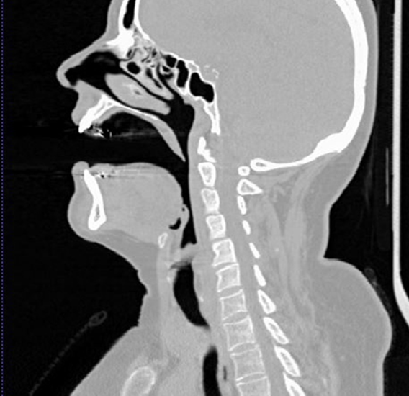
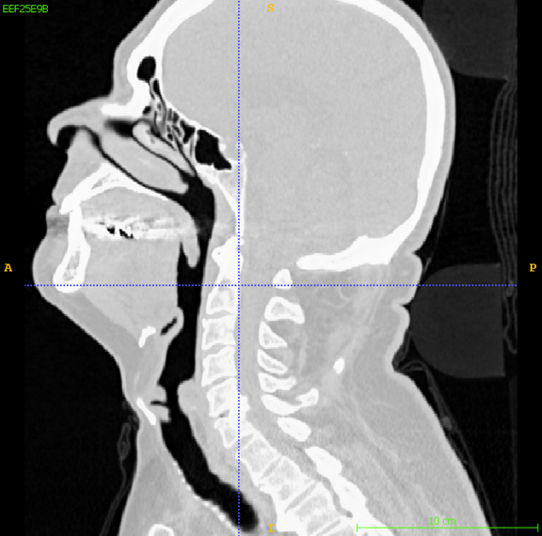
Geometrical Challenges
Protocol for CT imaging - is it repeatable?

Slide 5
Combining pre- and post-operative models
Pre-operative Post-operative

Slide 6
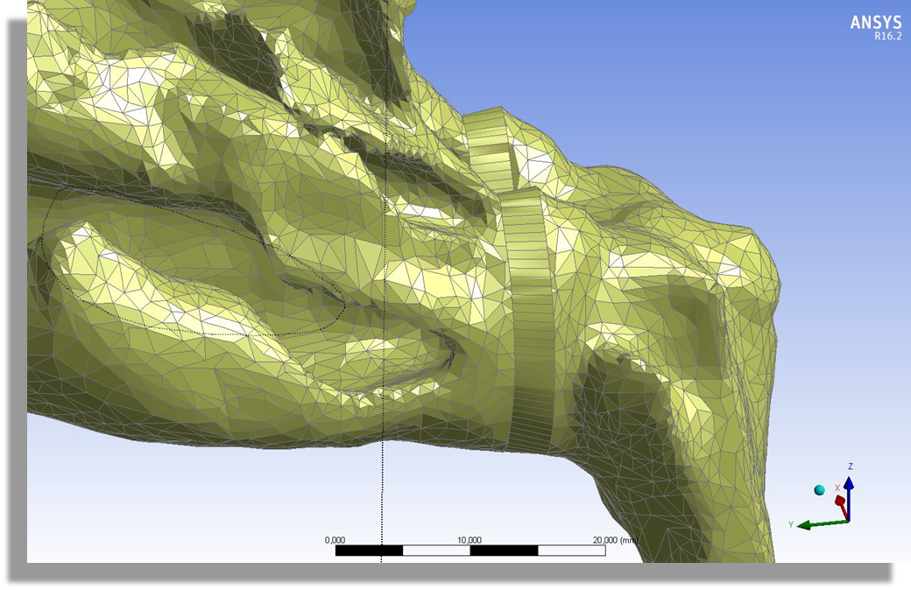
Combining pre- and post operative models
by Sverre G. Johnsen and Balram Panjwani (SINTEF MC)

Slide 7
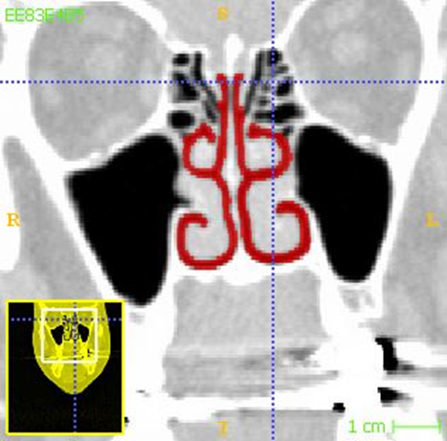
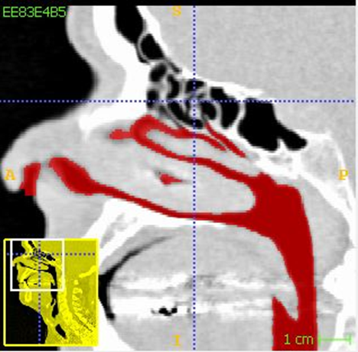
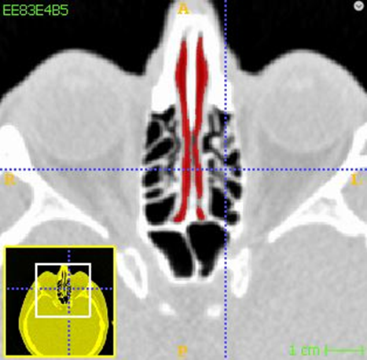
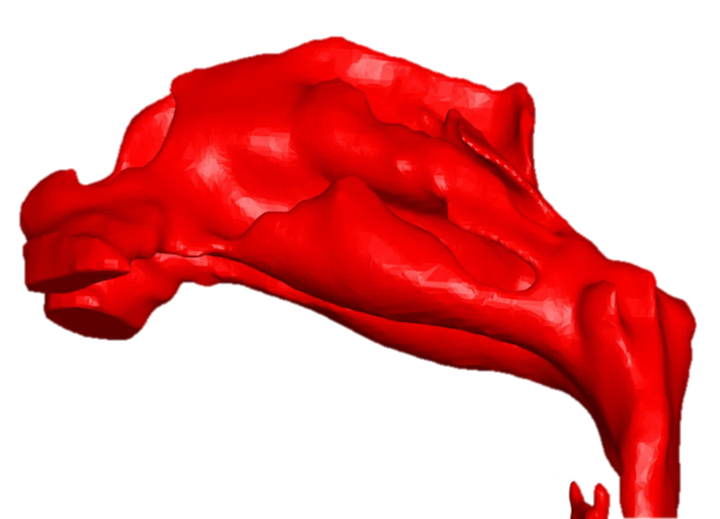
Is the segmentation repeatable?
Original
With Laplacian Smoothing filter

Slide 8
Numerical Simulation
Laminar flow, steady state, constant pressures at inlets and outlets, Pin = 0 Pa, Pout = -40Pa, 250ml/s at each inlet
Compare the effect of different inlets and outlets
Turbulence models?

